Slide 1
Initial Results: ICARUS Data-Driven Trigger Efficiency Measurement
Tanvi Krishnan
SLAC SULI Intern 2022

Slide 2
Motivation
The ICARUS detector collects hundreds of terabytes of data daily
The trigger system filters and keeps only the most interesting events, reducing the amount of data storage required
It is important to study the efficiency of the trigger in order to select the optimal level of filtering for the trigger
We plotted the efficiency as a function of different track characteristics (length, energy, starting and ending x coordinate, starting z coordinate)
We plotted the efficiency under different simulated trigger settings:
M1: 1 PMT pairs trigger S3: 3 PMT pairs trigger
S5: 5 PMT pairs trigger S8: 8 PMT pairs trigger
S10: 10 PMT pairs trigger S15: 15 PMT pairs trigger
M1 is the least restrictive, requiring only 1 PMT pair to detect light above the minimum threshold to trigger
S15 is the most restrictive, requiring 15 PMT pairs to detect light above the minimum threshold to trigger

Slide 3
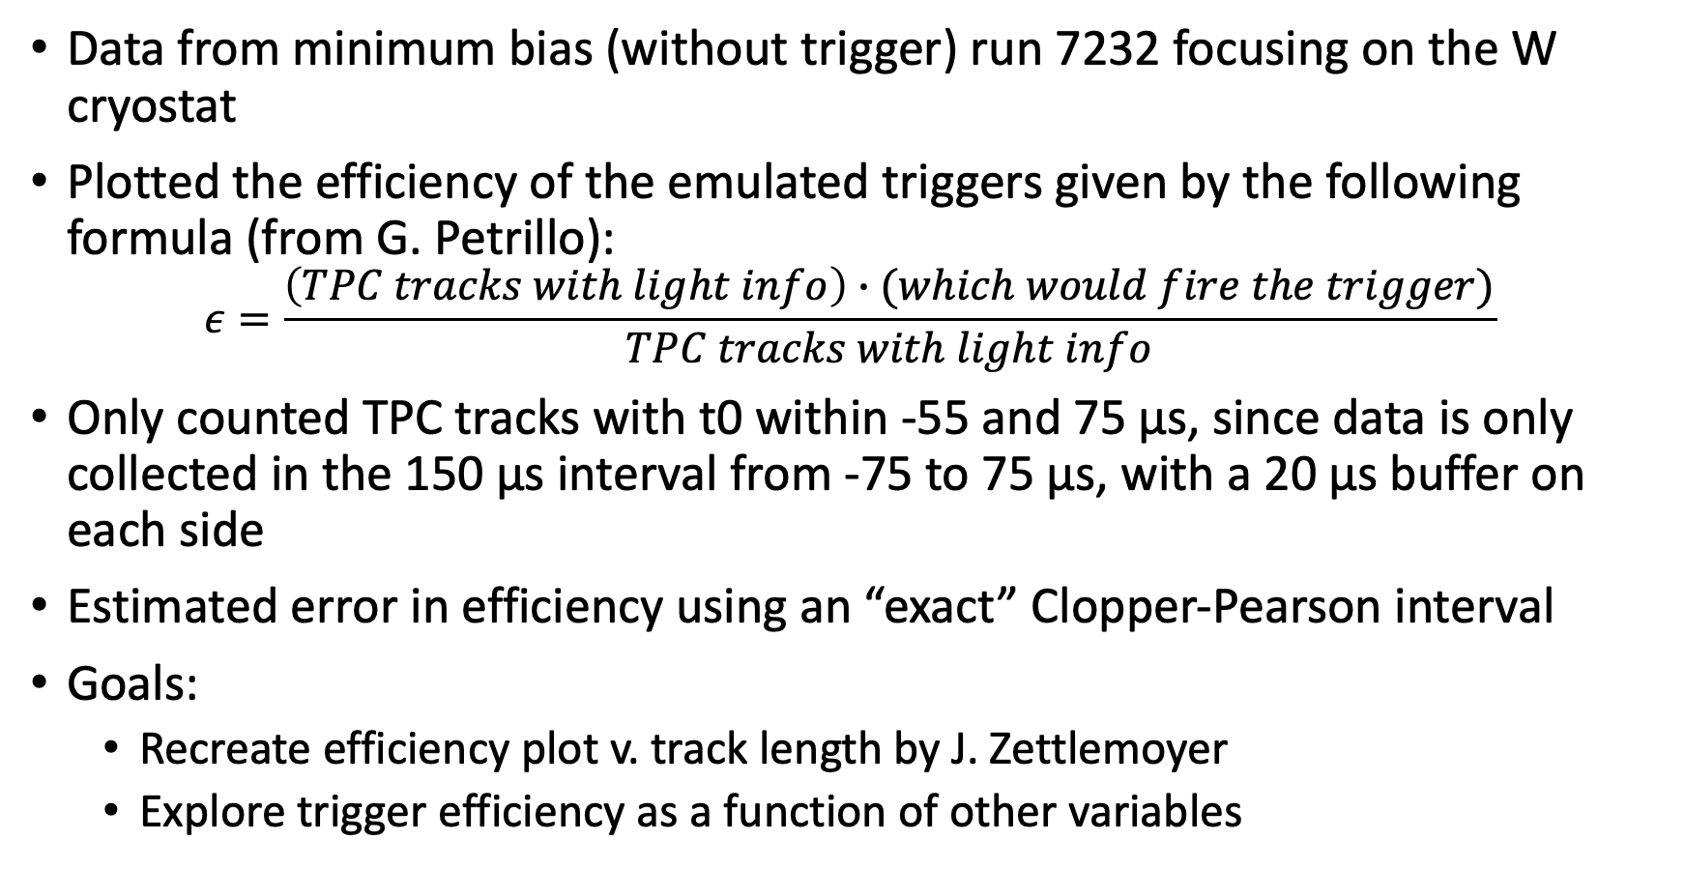
Methods
Data from minimum bias (without trigger) run 7232 focusing on the W cryostat
Plotted the efficiency of the emulated triggers given by the following formula (from G. Petrillo):
$$ε=\frac{\left(TPC tracks with light info\right)∙(which would fire the trigger)}{TPC tracks with light info}$$
Only counted TPC tracks with t0 within -55 and 75 µs, since data is only collected in the 150 µs interval from -75 to 75 µs, with a 20 µs buffer on each side
Estimated error in efficiency using an “exact” Clopper-Pearson interval
Goals:
Recreate efficiency plot v. track length by J. Zettlemoyer
Explore trigger efficiency as a function of other variables

Slide 4
Efficiency Plots
Using reconstructed cathode-crossing tracks from a minimum-bias data run with different trigger emulations

Slide 5
West Cryostat

Slide 6
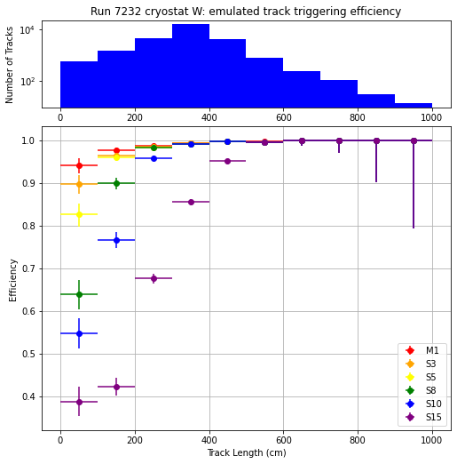

Trigger Efficiency for varying track length
Track lengths varied from 16cm to 1343 cm, but there were very few (<0.05%) tracks longer than 1000 cm, so I focused on tracks shorter than 1000 cm
90% Confidence Interval
95% Confidence Interval

Slide 7
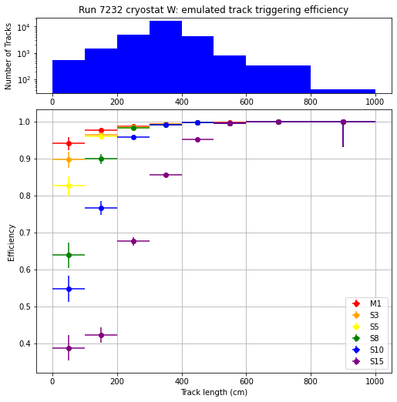

Trigger Efficiency for varying track length
Since the bins for larger track lengths have much smaller sample sizes, we can combine the bins for higher statistical accuracy
90% Confidence Interval
95% Confidence Interval

Slide 8
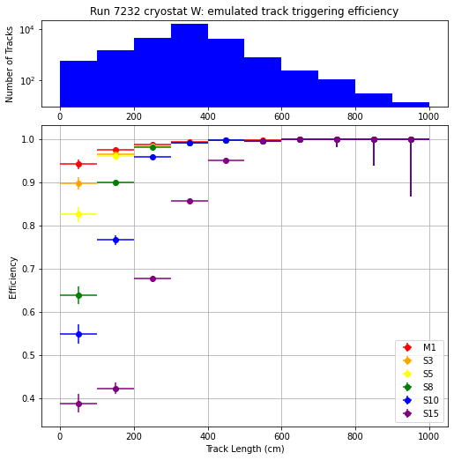
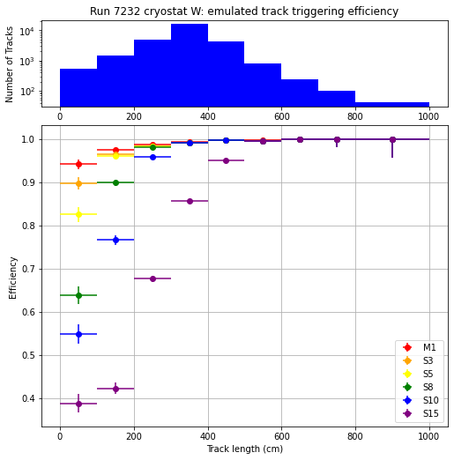
Trigger Efficiency for varying track length
Since the bins for larger track lengths have much smaller sample sizes, we can combine the bins for higher statistical accuracy. These plots use a 68.27% Confidence Interval with t0 ranging from -55 to 75 µm.
Equal Width Bins
With Bin Resizing

Slide 9
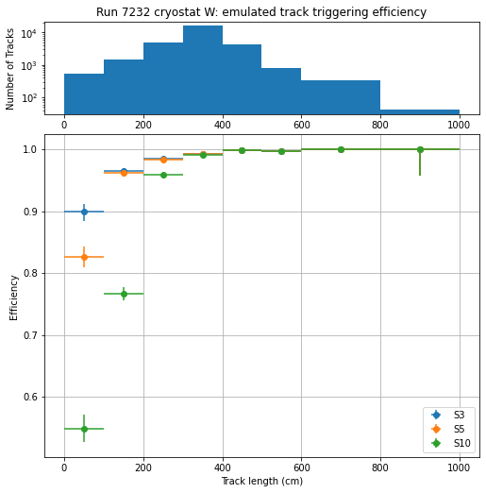
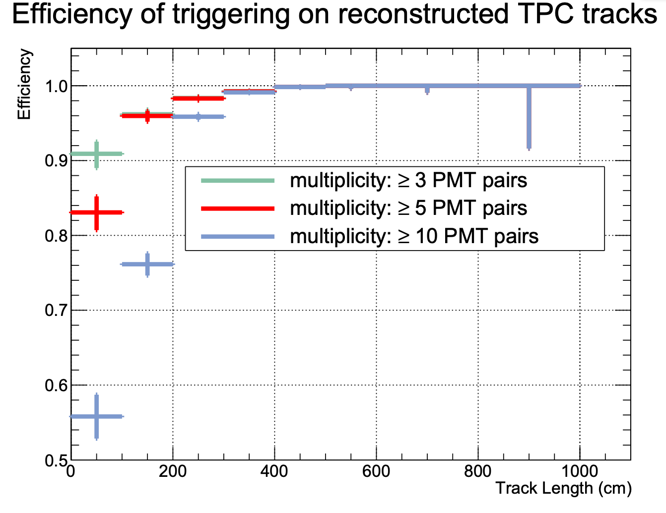
Trigger Efficiency for varying track length
I used this work to recreate a plot of trigger efficiencies by J. Zettlemoyer (SBN DocDB 26671)
68.27% Confidence Interval

Slide 10
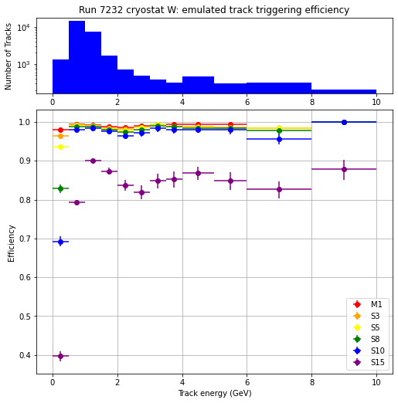
Trigger Efficiency for varying track energy
Track energies varied from 37 MeV to 1.4 TeV, but there were very few (<2%) tracks with more than 10 GeV of energy, so I focused on tracks with less than 10 GeV of energy
68.27% Confidence Interval
The efficiency peaks at about 0.8 GeV
There are multiple peaks for the efficiency plot which is interesting
Efficiency is very poor for less than 0.8 GeV of energy
Notes:
Units in MeV!!

Slide 11
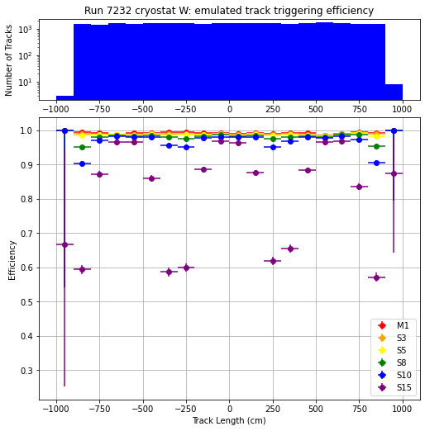
Trigger Efficiency for varying starting z-position of Tracks
Starting z-position varied from about -910 cm to 902 cm and appears to be roughly evenly distributed. The efficiency appears to have 3 peaks, most clear for S15 data. This makes sense as the cryostat has 3 sections along the z-axis, so efficiency is highest in the centers of those sections. The sliding door setup should eliminate this issue.
68.27% Confidence Interval
ICARUS West Cryostat Schematic, Top View
Anode
Cathode
Anode
z = 0 cm
West
East
x = 210 cm
(See slide 35)

Slide 12
Trigger Efficiency for varying starting x-position of Tracks
Starting and Ending x-position both varied from about 0 cm to 400 cm and appears to be roughly evenly distributed. These plots use a 68.27% Confidence interval. The efficiency is higher when the tracks don’t start or end close to the cathode.
x-position of start of track
x-position of end of track

Slide 13
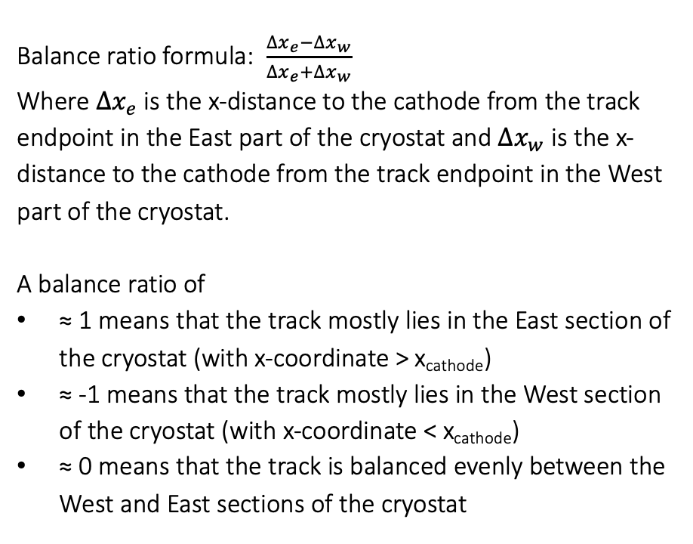
Trigger Efficiency as a function of the x-directional balance of tracks on either side of the cathode
68.27% Confidence Interval
Balance ratio formula: $\frac{∆x_{e}−∆x_{w}}{∆x_{e}+∆x_{w}}$
Where $∆x_{e}$ is the x-distance to the cathode from the track endpoint in the East part of the cryostat and $∆x_{w}$ is the x-distance to the cathode from the track endpoint in the West part of the cryostat.
A balance ratio of
≈ 1 means that the track mostly lies in the East section of the cryostat (with x-coordinate > x_{cathode})
≈ -1 means that the track mostly lies in the West section of the cryostat (with x-coordinate < x_{cathode})
≈ 0 means that the track is balanced evenly between the West and East sections of the cryostat

Slide 14
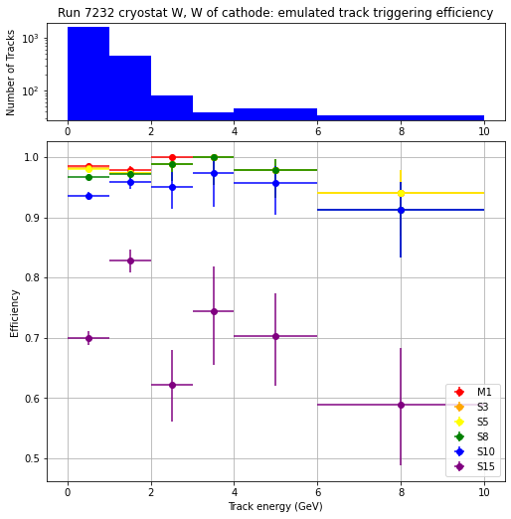
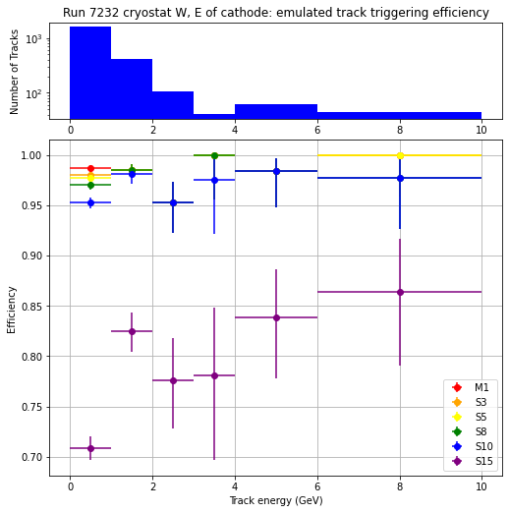
Trigger Efficiency for varying track energy for tracks primarily on one side of the cathode or the other
Balance ratio > 0.75 on the East side of the cathode and < -0.75 on the West side of the cathode. These plots use a 68.27% Confidence interval.

Slide 15
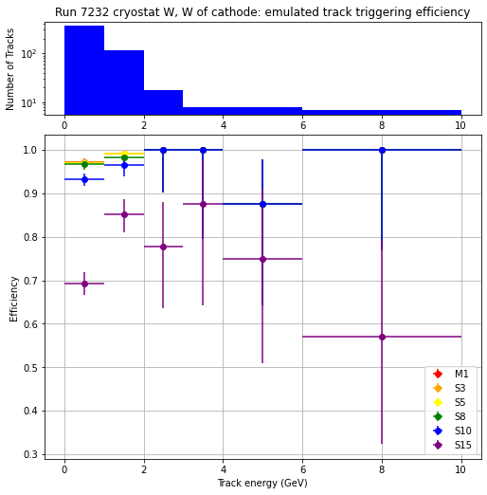
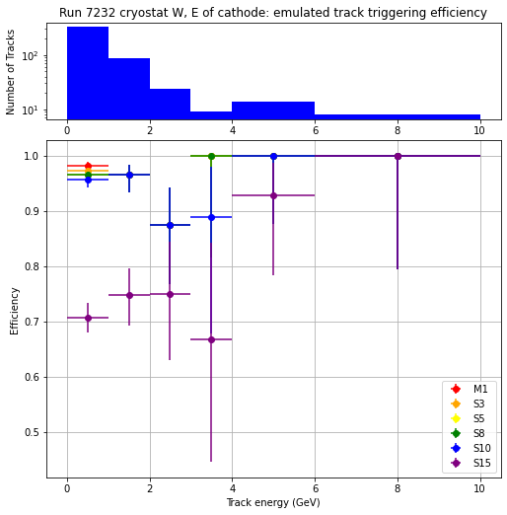
Trigger Efficiency for varying track energy for tracks primarily on one side of the cathode or the other
Balance ratio > 0.9 on the East side of the cathode and < -0.9 on the West side of the cathode. These plots use a 68.27% Confidence interval.

Slide 16
Trigger Efficiency for varying track length for tracks primarily on one side of the cathode or the other
Balance ratio > 0.75 on the East side of the cathode and < -0.75 on the West side of the cathode. These plots use a 68.27% Confidence interval.

Slide 17
Trigger Efficiency for varying track length for tracks primarily on one side of the cathode or the other
Balance ratio > 0.9 on the East side of the cathode and < -0.9 on the West side of the cathode. These plots use a 68.27% Confidence interval.

Slide 18
East Cryostat

Slide 19
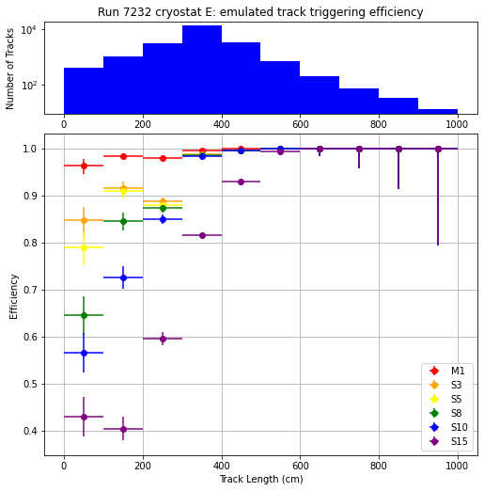

Trigger Efficiency for varying track length
Track lengths varied from 16cm to 1343 cm, but there were very few (<0.05%) tracks longer than 1000 cm, so I focused on tracks shorter than 1000 cm
90% Confidence Interval
95% Confidence Interval

Slide 20
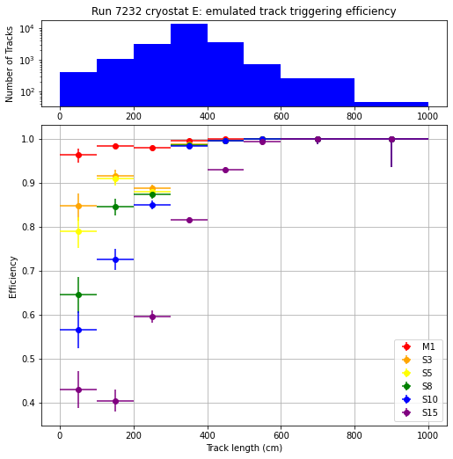

Trigger Efficiency for varying track length
Since the bins for larger track lengths have much smaller sample sizes, we can combine the bins for higher statistical accuracy
90% Confidence Interval
95% Confidence Interval

Slide 21
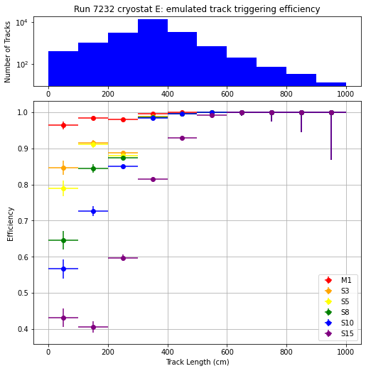

Trigger Efficiency for varying track length
Since the bins for larger track lengths have much smaller sample sizes, we can combine the bins for higher statistical accuracy. These plots use a 68.27% Confidence Interval with t0 ranging from -55 to 75 µm.
Equal Width Bins
With Bin Resizing

Slide 22
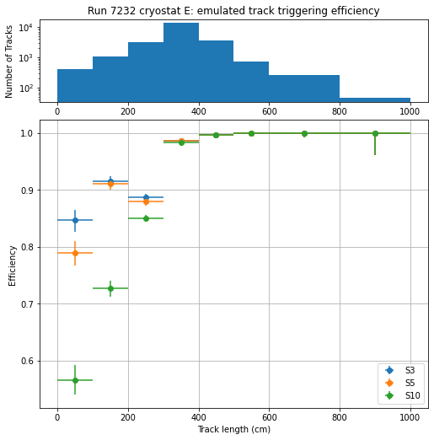
Trigger Efficiency for varying track length
I used this work to recreate a plot of trigger efficiencies by J. Zettlemoyer (SBN DocDB 26671)
68.27% Confidence Interval

Slide 23
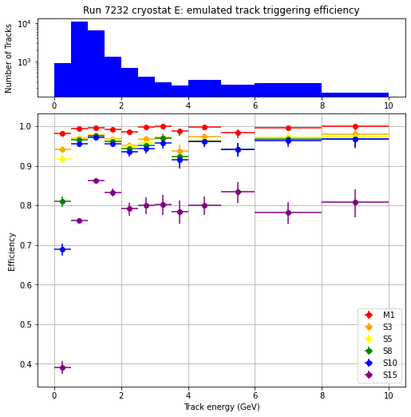
Trigger Efficiency for varying track energy
Track energies varied from 37 MeV to 1.4 TeV, but there were very few (<2%) tracks with more than 10 GeV of energy, so I focused on tracks with less than 10 GeV of energy
68.27% Confidence Interval
The efficiency peaks at about 0.8 GeV
There are multiple peaks for the efficiency plot which is interesting
Efficiency is very poor for less than 0.8 GeV of energy
Notes:
Units in MeV!!

Slide 24
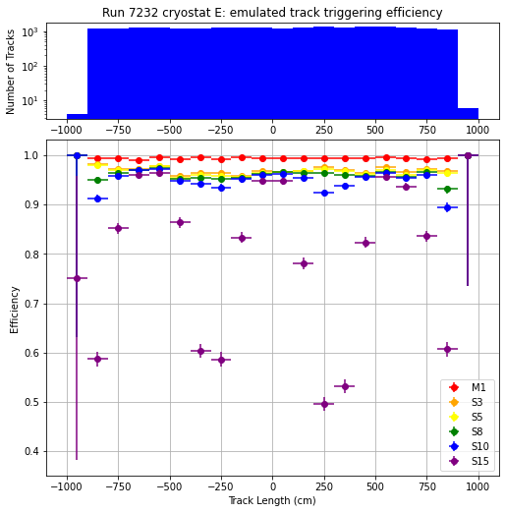
Trigger Efficiency for varying starting z-position of Tracks
Starting z-position varied from about -910 cm to 902 cm and appears to be roughly evenly distributed. The efficiency appears to have 3 peaks, most clear for S15 data. This makes sense as the cryostat has 3 sections along the z-axis, so efficiency is highest in the centers of those sections. The sliding door setup should eliminate this issue.
68.27% Confidence Interval
ICARUS West Cryostat Schematic, Top View
Anode
Cathode
Anode
z = 0 cm
West
East
x = -210 cm
(See slide 36)

Slide 25
Trigger Efficiency for varying starting x-position of Tracks
Starting and Ending x-position both varied from about 0 cm to 400 cm and appears to be roughly evenly distributed. These plots use a 68.27% Confidence interval. The efficiency is higher when the tracks don’t start or end close to the cathode.
x-position of start of track
x-position of end of track

Slide 26
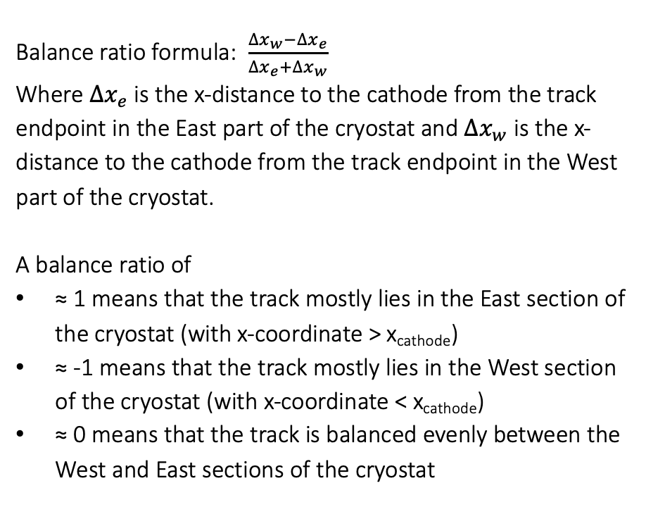
Trigger Efficiency as a function of the x-directional balance of tracks on either side of the cathode
68.27% Confidence Interval
Balance ratio formula: $\frac{∆x_{w}−∆x_{e}}{∆x_{e}+∆x_{w}}$
Where $∆x_{e}$ is the x-distance to the cathode from the track endpoint in the East part of the cryostat and $∆x_{w}$ is the x-distance to the cathode from the track endpoint in the West part of the cryostat.
A balance ratio of
≈ 1 means that the track mostly lies in the East section of the cryostat (with x-coordinate > x_{cathode})
≈ -1 means that the track mostly lies in the West section of the cryostat (with x-coordinate < x_{cathode})
≈ 0 means that the track is balanced evenly between the West and East sections of the cryostat

Slide 27
Trigger Efficiency for varying track energy for tracks primarily on one side of the cathode or the other
Balance ratio > 0.75 on the East side of the cathode and < -0.75 on the West side of the cathode. These plots use a 68.27% Confidence interval.

Slide 28
Trigger Efficiency for varying track energy for tracks primarily on one side of the cathode or the other
Balance ratio > 0.9 on the East side of the cathode and < -0.9 on the West side of the cathode. These plots use a 68.27% Confidence interval.

Slide 29
Trigger Efficiency for varying track length for tracks primarily on one side of the cathode or the other
Balance ratio > 0.75 on the East side of the cathode and < -0.75 on the West side of the cathode. These plots use a 68.27% Confidence interval.

Slide 30
Trigger Efficiency for varying track length for tracks primarily on one side of the cathode or the other
Balance ratio > 0.9 on the East side of the cathode and < -0.9 on the West side of the cathode. These plots use a 68.27% Confidence interval.

Slide 31
Next steps
Potentially collect another minimum bias run during the beam shutdown over a longer time period (this dataset was taken over an 8 hour interval) in order to obtain more precise efficiency plots for tracks primarily on one side of the cathode or the other
We are cutting our dataset significantly and in order to reduce the size of the uncertainty we need more data of this type
Obtain the CRT matched tracks to analyze trigger efficiency for these matched tracks, eliminating the barrier of only analyzing cathode-crossing tracks

Slide 32
Other data exploration

Slide 33
Time Difference between nominal trigger and beam gate
Time difference has 5 possible values, spaced 8 ns apart, from 120 ns to 152 ns. The mean time difference between nominal trigger and beam gate is 138.2 ns.

Slide 34
Time Difference between M1 trigger and t0 (track time)
The time difference should not be negative – this shift is an artifact of the reconstruction. The peak at -5 µs is the average time delay between the track and the trigger. There is also a peak at -20 µs. We used an interval from t₀ – 20 µs to t₀ to evaluate the trigger response, so any residual light from events before the start of the interval could activate the trigger response immediately upon the start of that interval, as the trigger can only be activated once per spill. This causes the initial spike that can be seen at -20 µs.
Notes:
Peak higher for easier to pass triggers

Slide 35
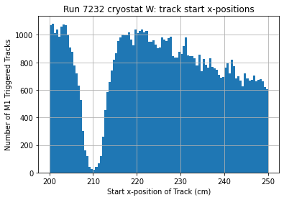
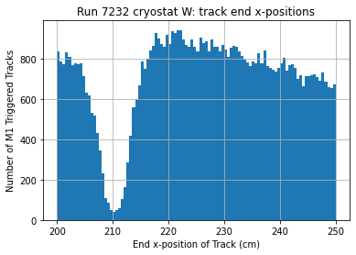
X-position of cathode – cryostat W
The start x-positions of tracks range from 0 to 400 cm, approximately, and there was a sharp drop in the number of tracks that start and end at x = -210 cm which indicates that this is the x-position of the cathode. We make use of this information on slide 13.

Slide 36
X-position of cathode – cryostat E
The start x-positions of tracks range from 0 to 400 cm, approximately, and there was a sharp drop in the number of tracks that start and end at x = 210 cm which indicates that this is the x-position of the cathode. We make use of this information on slide 26.

Slide 37
Additional information

Slide 38
Data used in this presentation can be found at the following directory:
/pnfs/icarus/persistent/users/jzettle/trigger_eff/minbias/run7232_initialenergyest/run7232_merged_energyest.root

